Slide 1
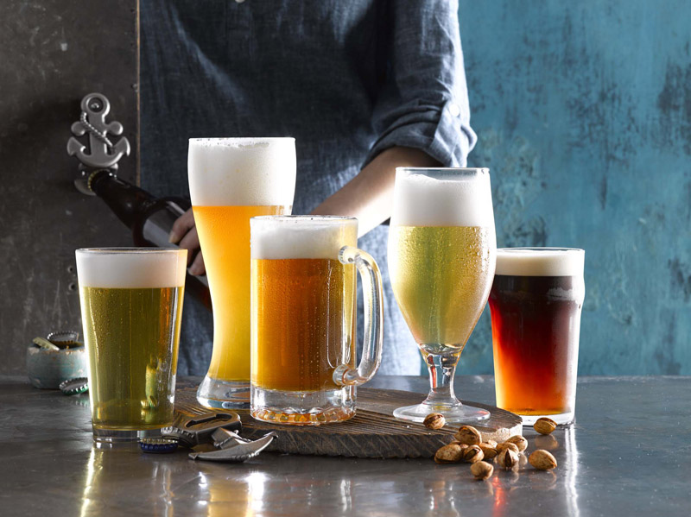
Beer Analysis
Group A:
Jay Kansara
Mugunthan Rengarajah
Alex Zhang
Shamay Bahar

Slide 2
Data Description
Source: The data was sourced from Kaggle consisting three CSV files
beers.csv
breweries.csv
reviews.csv
Why this topic: After brainstorming, we selected this topic and dataset amongst four other potential datasets based on the following criteria:
Volume of data
Number of variables
Mutual interest

Slide 3
Data Structure
 | Number of rows | Null Values count | Data Type
beers.csv | 358,873 | 60,726 | 1 float, 1 integer and 7 objects
breweries.csv | 50,347 | 11,271 | All columns with object data types
reviews.cs | 9,073,128 | 3,790,018 | 6 float and 3 object columns

